Slide 1

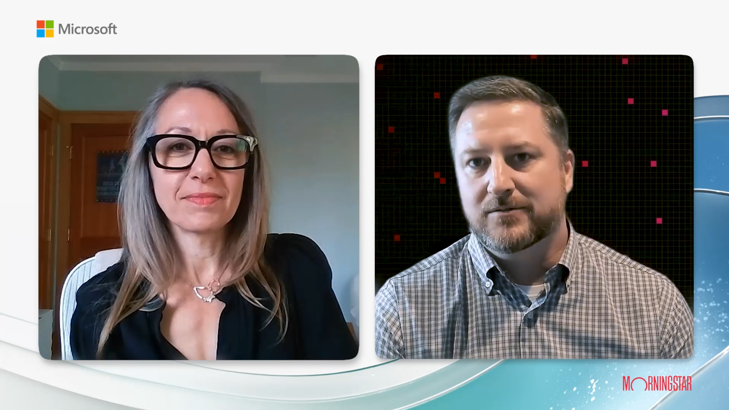
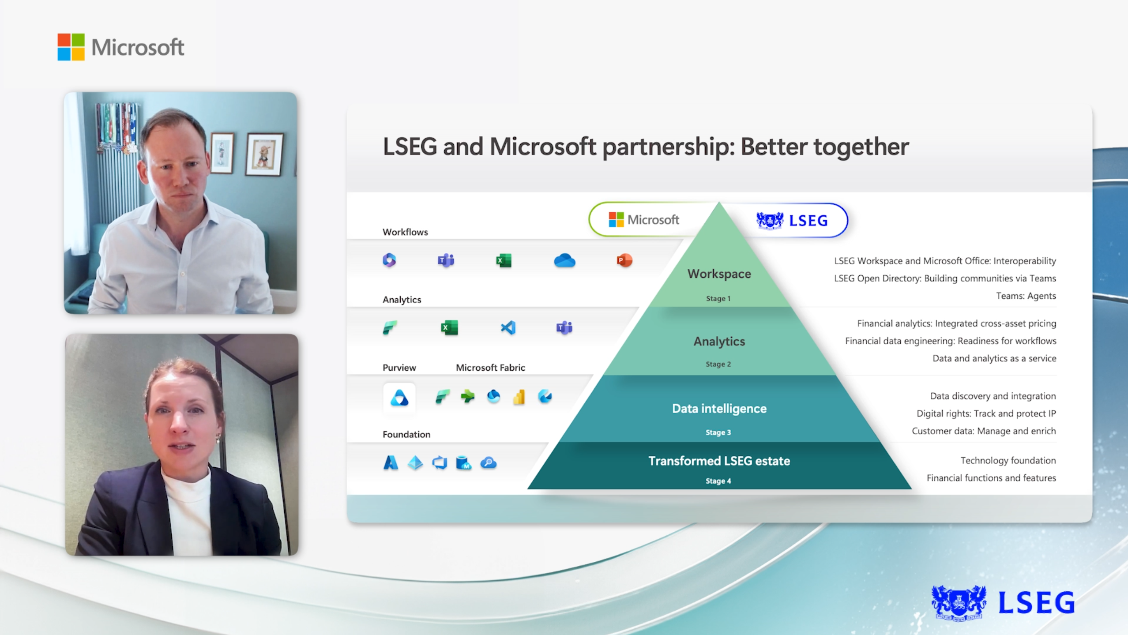
Microsoft Industry Education Marketing Webcasts
Microsoft Financial Services industry team partnered with Affirma to create informative webcasts designed to educate their audience on the benefits of their new AI-powered platforms. The webcasts featured engaging discussions between Microsoft’s team and customer stakeholders, effectively illustrating how Microsoft's platforms positively impacted their customers' businesses
Our Work
Established video production timelines and milestones with stakeholders
Sourced and implemented approved brand assets from Microsoft and partner brands
Conducted remote on-camera recording of 3 webcast episodes​
Designed title and background graphics for use across all episodes
Perfected the video cuts and incorporated stakeholder feedback during rounds of revision
Created and QA’d caption files for a variety of formats. (SRT, VTT, TTML and TXT files)​
The Result
Delivery of 3 webcast episodes covering Microsoft’s partners’ unique use-cases for their AI-Powered platforms
Do we know where these videos live now so that we can link here?

